Slide 1

Academic Integrity:
The
University
of the
West Indies
Cave Hill Campus
Sidney Martin Library
The Hallmark of a Successful Academic & Professional Career

Slide 2
What IS AcadeMIc INTEGRITY
Academic Integrity refers to the honest and responsible pursuit of scholarship and learning.
It is one of the most important values of any university community as both the work and the reputation of the university are dependent on the maintenance of high standards of academic integrity.

Slide 3
WhaT IS Your Responsibility
As a student of The University of the West Indies (UWI) you need to ensure that:
The UWI continues to be regarded as an institution whose reputation is built on the integrity of the work produced by the members of its community.
The degree you earn at the end of the process is a testament to honest effort and genuine learning.
You are fully conversant with the academic policy of The UWI regarding PLAGIARISM.

Slide 4
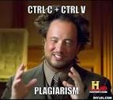
Plagiarism at The UWI is
“The unacknowledged and unjustified use of words, ideas or creations of another, including unacknowledged quotation and unjustified unattributed borrowing...” (University Regulations on Plagiarism (First Degrees, Diplomas and Certificates) (The University of the West Indies Cave Hill Campus)
“…Knowledge without integrity is dangerous
and dreadful.”
- Samuel Johnson

Slide 5

How do you plagiarize
You do so when you:
Rewrite information from books, articles, documents etc. without giving credit
Copy and paste from web pages and online sources to create ‘patchwork’ writing
Buy, download or borrow a paper
Recycle an old paper aka self plagiarism

Slide 6

HOW DO YOU Avoid plagiarism
By using proper documentation methods
in your academic writing.
What is Documentation?
it is how you explain where you got the information you used in your paper.
As a student of The UWI documentation will therefore be an essential component of every academic paper you are required to produce.

Slide 7
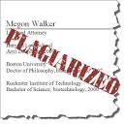
Why does documentation matter
Documentation enables you to –
Distinguish your original ideas from borrowed ideas
Help readers to locate information for further research
Add authority and context to your own writing
Acknowledge the work of others
Avoid committing plagiarism

Slide 8
When do YOU need to DOCUMENT
Use of someone’s ideas, opinions or theory irrespective of the medium of the content.
Use of information gained from interviewing someone or from an interview whether you use their exact words or paraphrase.
Use of statistics, graphs, charts, diagrams or any form of visual whether obtained from a printed source or electronic source.

Slide 9
When don’t you need to document
Writing of your own experiences, observations, insights, thoughts or conclusions about a subject.
Use of “common knowledge”- facts which can be found in numerous places i.e. you can find the same information undocumented in at least five sources; you think it is information that readers already know; or a person can easily find the same information using general reference sources.
Write up of your own experimental results.

Slide 10
HOW DO YOU DOCUMENT?
There are two components to documentation:
In-text citations - provide a brief reference of the source found at the end of your paper. It is a quick way to let readers know that you have used outside information.
Reference or Works Cited List - provides complete bibliographic information for all the sources you cited in-text. Comes at the end of your paper and is generally organised alphabetically.

Slide 11
How do you Represent someone’s ideas in your paper
You can either use DIRECT QUOTES as in the preceding example where you reproduce verbatim what the author has said OR you can PARAPHRASE.
Paraphrasing is the process of expressing the ideas contained in a source in your own words, whilst still preserving the essential ideas of the original source.
Paraphrasing is recommended to a prolific use of direct quotes. Too many direct quotes in your paper is an indication that you have not understood the content.

Slide 12
Here is an Example
In-text citation – Direct quote:
The importance of teaching information literacy skills is even more important today and consequently “librarians and faculty are collaborating like never before to train students in information and technology work… so that ultimately they can be successful in the electronic environment.” (Rader 2006)
In-text citation – Paraphrase:
Rader (2006) opines that the increasing importance of information literacy to education is now evident in the changes being seen in the higher education sector resulting in the forging of new partnerships between faculty and librarians to teach students the requisite information and technology skills. She concludes that the teaching of these skills is critical if students are to be able to function effectively in the global information environment.

Slide 13
Example continued
Full citation to the book in Reference or Works Cited List:
Chicago Style:
Rader, Patricia. 2006. Higher Education in the Internet Age. London: Wiley.
MLA:
Rader, Patricia. Higher Education in the Internet Age. London: Wiley, 2006. Print
APA:
Rader, Patricia. (2006). Higher education in the internet age. London: Wiley.

Slide 14
Basic Elements of a Citation
BOOK:
Author
Title of book
Place of publication
Publisher
Year of publication
JOURNAL:
Author of article
Title of article
Title of journal
Volume
Issue
Year
Inclusive page numbers of article
BOOK CHAPTER:
Author of chapter
Title of chapter
Title of book
Editor of book
Place of publication
Publisher
Year of publication
Inclusive page numbers of chapter

Slide 15
if you fail to document
You risk a failing grade and/or expulsion from the University. Therefore :
Make sure you know how to document correctly using the documentation style of your respective faculty.
Make it a habit to practice documenting as a normal course of your daily routine when you conduct research in addition to writing.
Make sure you are fully conversant with The UWI’s policy on Plagiarism.

Slide 16
Plagiarism detection
The UWI Regulations on Plagiarism make provision for
the use of software to detect plagiarism .
At Cave Hill the Turnitin text-checking software is used by faculty to check submitted papers for plagiarism.
Students have access to the software through their e-learning course site(s) and can or may be required to vet their papers using the software prior to submission.

Slide 17
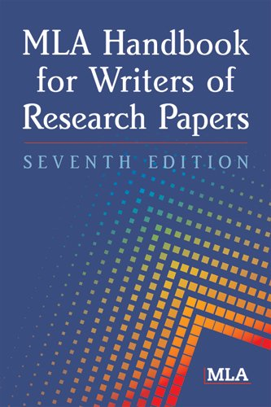
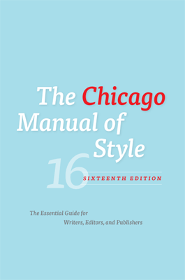
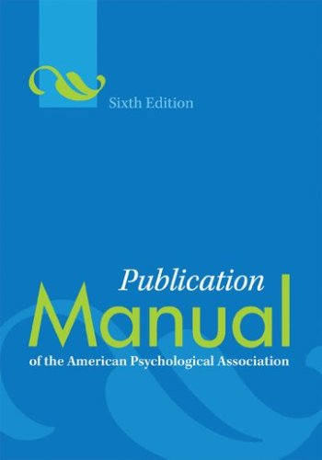

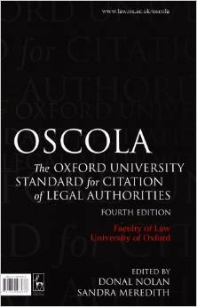
The Documentation styles

Slide 18
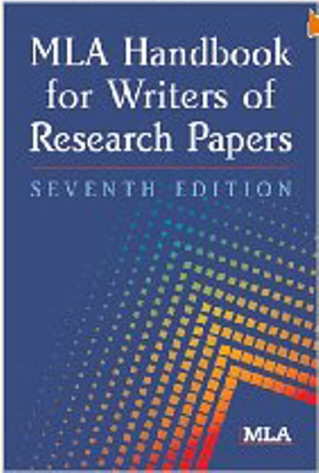
Mla & APA Styles
Faculty of Humanities & Education
MLA Handbook for Writers of Research
Papers, 7th ed.
Call no: LB2369.G53 2009
School of Education
Publication Manual of the American
Psychological Association, 6th ed.
Call no: BF76.7.P83 2010

Slide 19
Chicago Style
Faculties of Social Sciences & Science
& Technology
The Chicago Manual of Style, 16 ed.
Call no: Z253.U69 2010
Also accessible online via UWILinc

Slide 20
ACS Style
Faculty of Science & Technology;
Discipline of Chemistry
The ACS Style Guide, 3rd ed.
Call no: QD8.5.A25 2006

Slide 21
Vancouver Style
Faculty of Medicine – There is not a published manual for this style. The recommended site for details on the formatting for the style is:
https://workspace.imperial.ac.uk/library/Public/vancouver_referencing.pdf

Slide 22
OSCOLA Style
Faculty of Law
The Oxfords Standard for Citation of Legal Authorities, 4th ed.
Call no. REF K114 082 2010

Slide 23
UWI Policy Documents
The UWI Plagiarism Policy
http://www.cavehill.uwi.edu/mainlibrary/docs/regulations-for-plagarism.aspx
Plagiarism Accountability Statement
http://www.cavehill.uwi.edu/mainlibrary/docs/plagiarismaccountabilitystatement2011-en.aspx

Slide 24
Need to Know More!
Visit the library and consult with your Faculty Librarian or the Librarian on Reference Duty.
Read the library’s website regularly. The library will sometimes advertise training sessions for which you can sign up.
If you think the entire class needs a hands-on session, ask your Lecturer to contact your Faculty Librarian.

Slide 25
Your Faculty librarians
Science & Technology – Ingrid Iton, ext. 4841, Room 306, Sidney Martin Library margaret.iton@cavehill.uwi.edu
Humanities & education – Ingrid Iton
Social Sciences – Judith Toppin, ext. 4845, Room 206, Sidney Martin Library judith.toppin@cavehill.uwi.edu
Medical Sciences – Valerie Clarke, ext. 4201, Elizabeth Watson Audio Visual Library valerie.clarke@cavehill.uwi.edu
Thank You

